Slide 1



Frequency of Mature Planets orbiting neighboring stars
Brandon Bass
April 14th 2018
University of Arizona
Nasa space grant

Slide 2

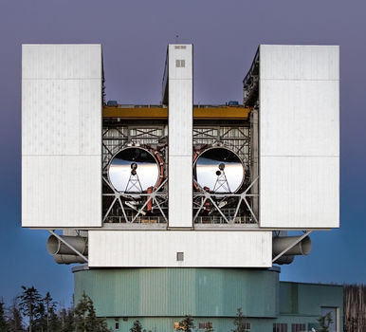
Introduction
Question: How common are solar systems like our own, in the Milky Way galaxy?
Method: Observe infrared light at 3.8 microns to uncover planets where they are brightest.
Telescope: Large Binocular Telescope on Mount Graham in Safford, AZ
*Picture curtesy of the NASA Jet Propulsion Laboratory
Notes:
Large Binocular Telescope, the largest single-mount telescope in the world. Mount graham in safford, AZ

Slide 3
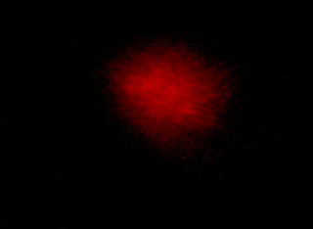
Adaptive Optics
High-resolution imaging allows the team to separate planet light from star light.
Phil Hinz LBTI
Notes:
“Provides high-resolution images of faint objects over a wide field-of-view, including galaxies in the Hubble Deep Field with 10 times the Hubble resolution (NASA Jet Propulsion Laboratory).”

Slide 4
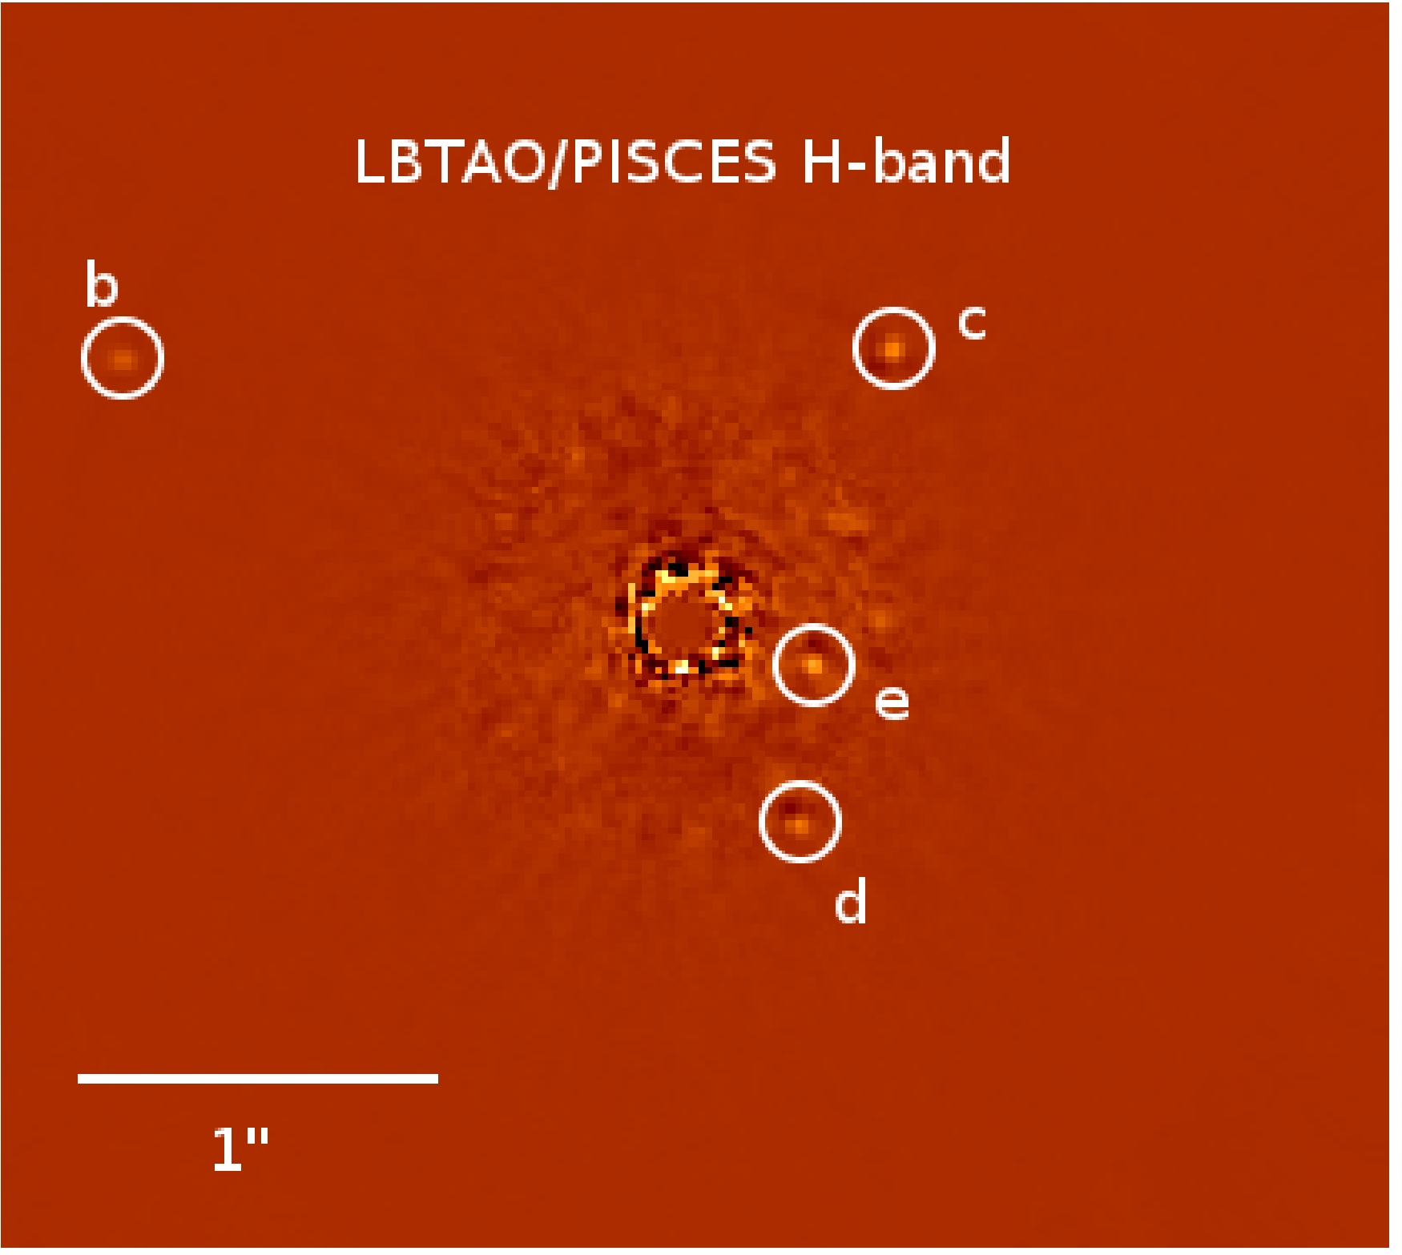
The Survey
Performed a survey of 98 nearby stars, looking for new planets.
LBTI is sensitive enough to detect light from planets greater than or equal to 5x the mass of Jupiter, shown right.
The survey constrained how common wide orbit gas giants are, concluding that they are rare.
A. Skemer et al. 2012

Slide 5


Optimizing LBTI Observations
Telescope time is extremely expensive, we want to design observations to deliver the highest sensitivity.
My work has been to analyze the previous survey’s meta data to identify the observing strategies and environmental conditions that produce the optimal imaging.

Slide 6
The Variables under Consideration
Variable | Explanation
Exposure (s) | How much time was spent capturing data on a specific solar system
Rotation (degrees) | How much the sky rotated during observation
Telescope | Right, left, or both sides
Star brightness (magnitudes) | Documented star brightness, luminosity
Absolute sensitivity (magnitudes) | How faint of planets could be detected
Contrast Separation (magnitudes) | How much fainter than the star could we get the planets to appear
Seeing (seconds of arc) | The blurring and twinkling of stars due to the atmosphere

Slide 7
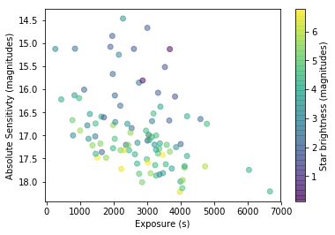
The DATA
Notice that the absolute sensitivity (how faint of objects we were able to see) tends to increase with exposure in an inverse exponential fashion
We also found that the stars that are the least bright seemed to produce the best results
Notes:
The graph on the right shows that there is strong correlation between background sensitivity and exposure time.
Back+L -> absolute sensitivity at large separation (magnitudes)
EXP -> Exposure time (s)
Speck -> contrast at short separation (how much fainter than the star) (magnitudes)
L -> star brightness in magnitudes (brighter stars are lower)

Slide 8
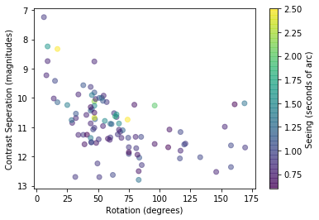
A different Perspective
After about 80 degrees of rotation there is no real improvement in the results
The survey subjects with a seeing of about 1.25 and lower performed the best
Notes:
Fix the fit
Once you hit about 80 degrees of rotation we don’t see much improvement afterwords

Slide 9
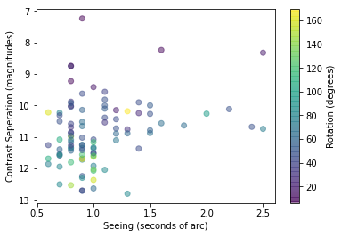
A Closer Look at Seeing
The last graph noted that lower seeing values generally produce better results.
Now we have constrained that ‘lower’ value to at or under 1 seconds of arc.
Additionally, all the best values also have a higher rotation value as well.

Slide 10
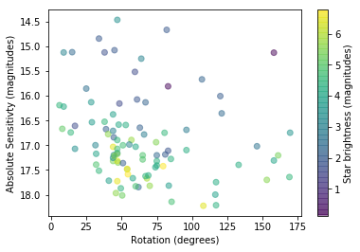
Future Work
Exploring the outliers, why stars of similar circumstances can be more than two magnitudes different in sensitivity
To do this, we will be looking at a more detailed second by second frame of observing and taking a look at more specific weather data

Slide 11


Thank you to Jordan Stone my advisor for introducing me to the world of astronomy
Thank you U of A NASA Space Grant staff for making this all happen

